Slide 1
Computer Vision
Spring 2018
Problem Set #5
Sergiy Palguyev
Sergiy.Palguyev@gatech.edu
Computer Vision @ GT

Slide 2
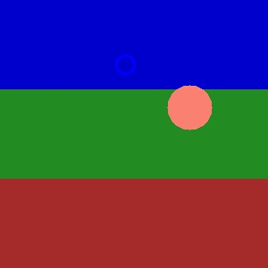

1b: KF Tracking a circle
ps5-1-b-1.png
Computer Vision @ GT

Slide 3

1b: KF Tracking a circle (cont.)
ps5-1-b-2.png
Computer Vision @ GT

Slide 4
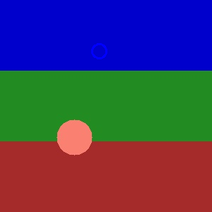
1b: KF Tracking a circle (cont.)
ps5-1-b-3.png
Computer Vision @ GT

Slide 5

1b: KF Tracking a circle (cont.)
ps5-1-b-4.png
Computer Vision @ GT

Slide 6
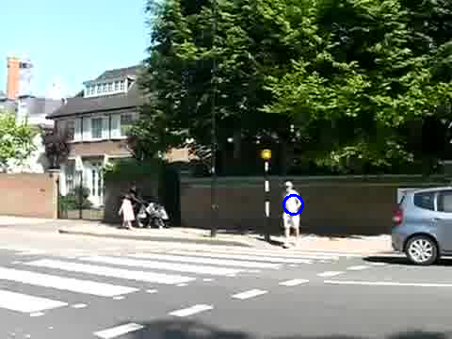
1c: KF Tracking pedestrians
ps5-1-c-1.png
Computer Vision @ GT

Slide 7
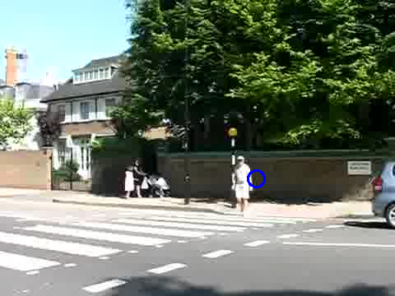
1c: KF Tracking pedestrians
ps5-1-c-2.png
Computer Vision @ GT

Slide 8
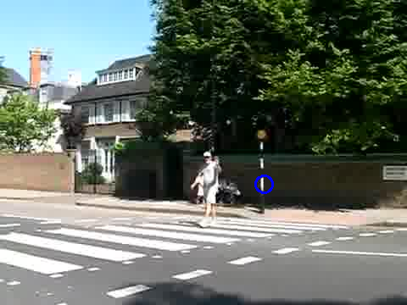
1c: KF Tracking pedestrians
ps5-1-c-3.png
Computer Vision @ GT

Slide 9
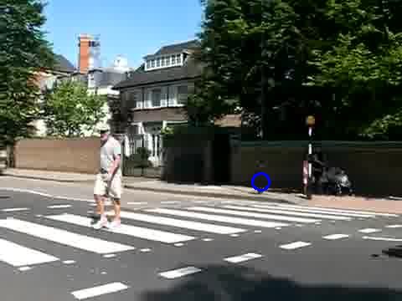
1c: KF Tracking pedestrians
ps5-1-c-4.png
Computer Vision @ GT

Slide 10
2a: PF Tracking a circle
ps5-2-a-1.png
Computer Vision @ GT

Slide 11
2a: PF Tracking a circle (cont.)
ps5-2-a-2.png
Computer Vision @ GT

Slide 12
2a: PF Tracking a circle (cont.)
ps5-2-a-3.png
Computer Vision @ GT

Slide 13
2a: PF Tracking a circle (cont.)
ps5-2-a-4.png
Computer Vision @ GT

Slide 14
2b: PF Tracking noisy video
ps5-2-b-1.png
Computer Vision @ GT

Slide 15
2b: PF Tracking noisy video (cont.)
ps5-2-b-2.png
Computer Vision @ GT

Slide 16
2b: PF Tracking noisy video (cont.)
ps5-2-b-3.png
Computer Vision @ GT

Slide 17
2b: PF Tracking noisy video (cont.)
ps5-2-b-4.png
Computer Vision @ GT

Slide 18
3a: PF Changes in Appearance
ps5-3-a-1.png
Computer Vision @ GT

Slide 19
3a: PF Changes in Appearance (cont.)
ps5-3-a-2.png
Computer Vision @ GT

Slide 20
3a: PF Changes in Appearance (cont.)
ps5-3-a-3.png
Computer Vision @ GT

Slide 21
4a: PF Occlusions
ps5-4-a-1.png
Computer Vision @ GT

Slide 22
4a: PF Occlusions (cont.)
ps5-4-a-2.png
Computer Vision @ GT

Slide 23
4a: PF Occlusions (cont.)
ps5-4-a-3.png
Computer Vision @ GT

Slide 24
4a: PF Occlusions (cont.)
ps5-4-a-4.png
Computer Vision @ GT

Slide 25
4: Text response
Computer Vision @ GT

Slide 26
5: Tracking multiple targets
ps5-5-a-1.png
Computer Vision @ GT

Slide 27
5: Tracking multiple targets (cont.)
ps5-5-a-2.png
Computer Vision @ GT

Slide 28
5: Tracking multiple targets (cont.)
ps5-5-a-3.png
Computer Vision @ GT

Slide 29
5: Text response
Computer Vision @ GT

Slide 30
6: Challenge Problem
ps5-6-a-1.png
Computer Vision @ GT

Slide 31
6: Challenge Problem (cont.)
ps5-6-a-2.png
Computer Vision @ GT

Slide 32
6: Challenge Problem (cont.)
ps5-6-a-3.png
Computer Vision @ GT

Slide 33
6: Challenge Problem Text response
Computer Vision @ GT

